Slide 1
Chemistry:
The Study of Change
Chapter 1
Copyright © The McGraw-Hill Companies, Inc. Permission required for reproduction or display.

Slide 2
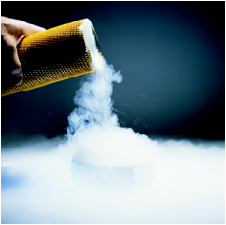
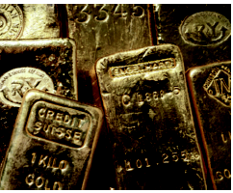
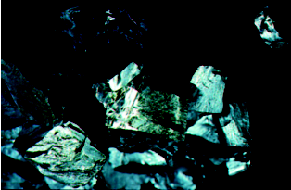
Chemistry is the study of matter and the
changes it undergoes
Matter is anything that occupies space and has mass.
A substance is a form of matter that has a definite composition and distinct properties.
liquid nitrogen
gold ingots
silicon crystals

Slide 3
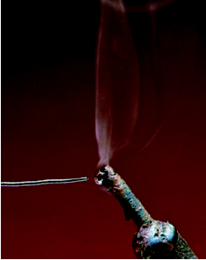
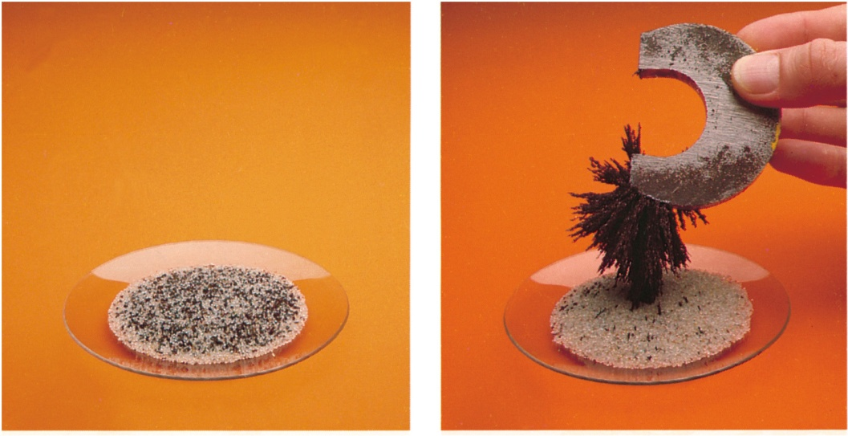
A mixture is a combination of two or more substances in which the substances retain their distinct identities.
Homogenous mixture – composition of the mixture is the same throughout.
soft drink, milk, solder
Heterogeneous mixture – composition is not uniform throughout.
cement,
iron filings in sand

Slide 4
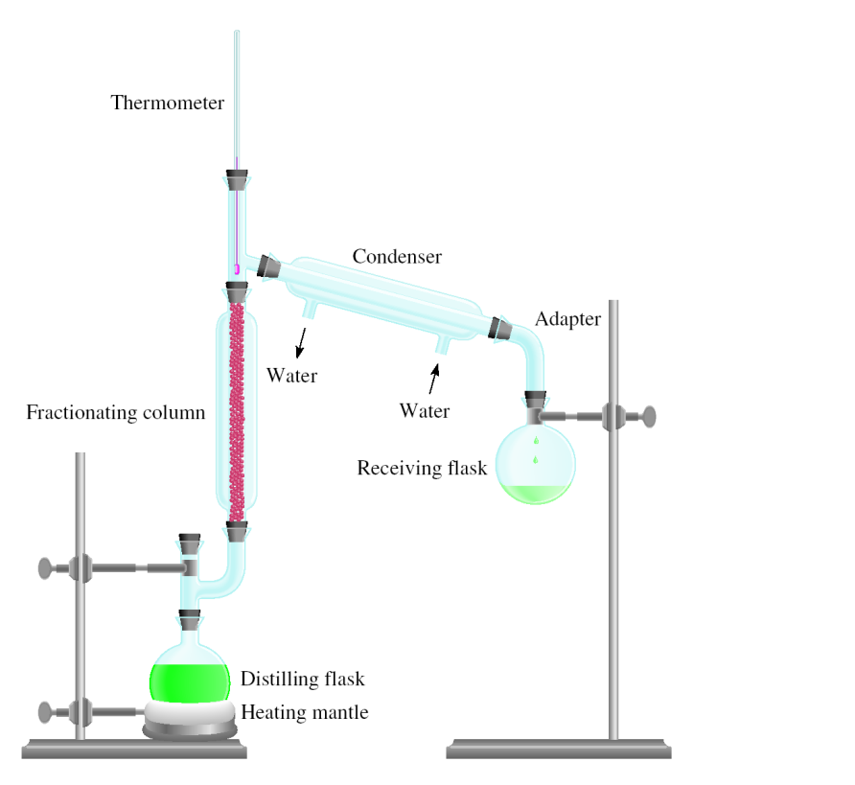
Physical means can be used to separate a mixture into its pure components.
magnet
distillation

Slide 5
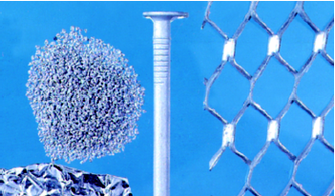
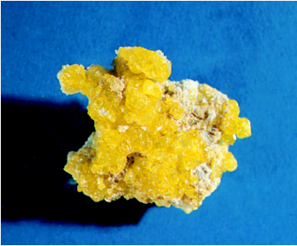
An element is a substance that cannot be separated into simpler substances by chemical means.
  118 elements have been identified
    94 elements occur naturally on Earth
      gold, aluminum, lead, oxygen, carbon, sulfur
    24 elements have been created by scientists
      technetium, americium, seaborgium

Slide 6
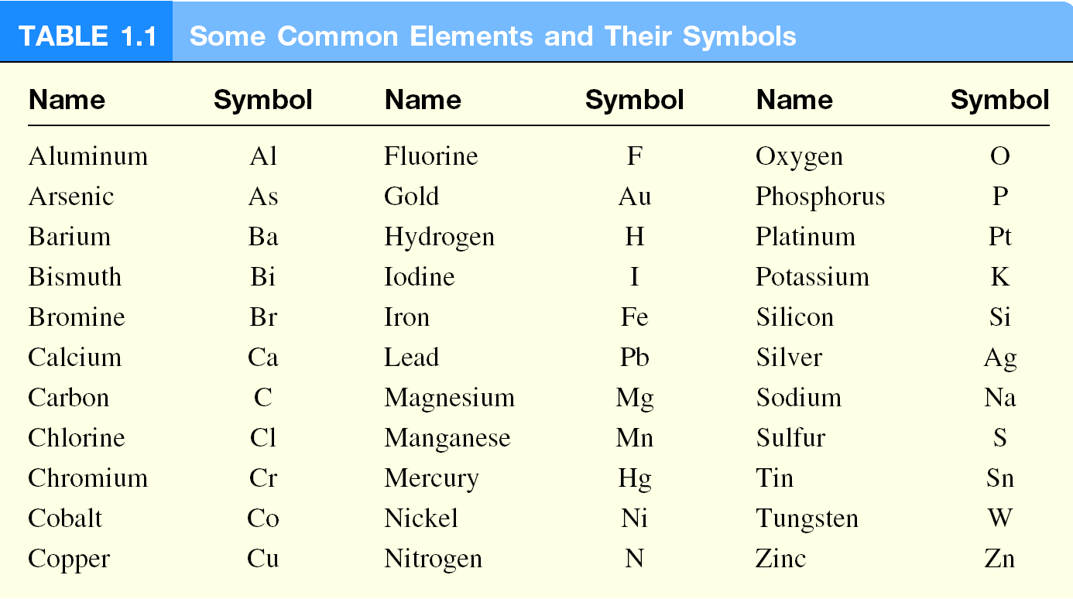

Slide 7
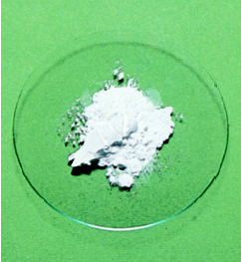
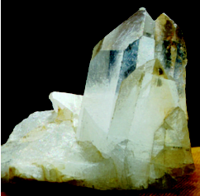
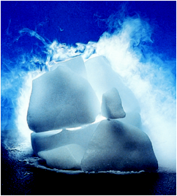
A compound is a substance composed of atoms of two or more elements chemically united in fixed proportions.
Compounds can only be separated into their pure components (elements) by chemical means.
lithium fluoride
quartz
dry ice – carbon dioxide

Slide 8
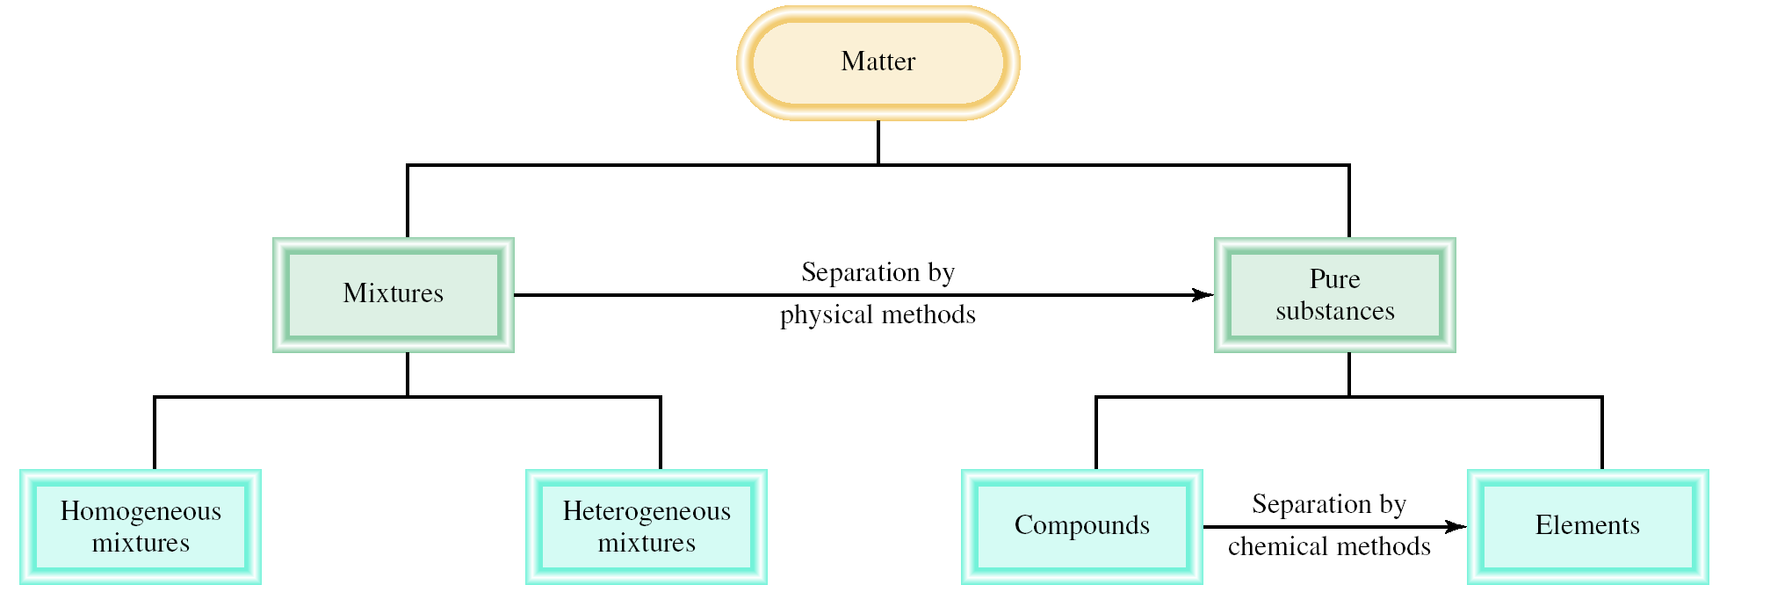
Classifications of Matter

Slide 9
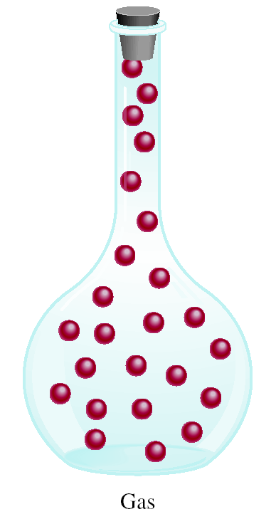
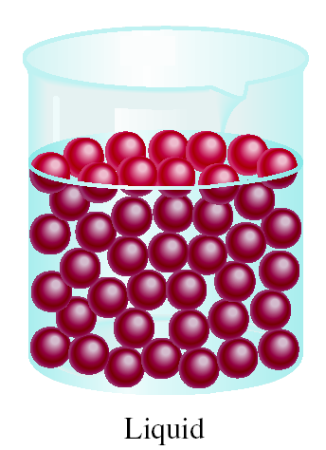
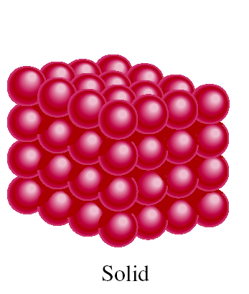
A Comparison: The Three States of Matter

Slide 10
The Three States of Matter: Effect of a Hot Poker on a Block of Ice
GAS
Vaporization
(heat or reduce pressure)
Condensation
(cool or increase pressure)
LIQUID
Liberates Energy
Requires Energy
Melting
(heat)
Freezing
(cool)
SOLID

Slide 11
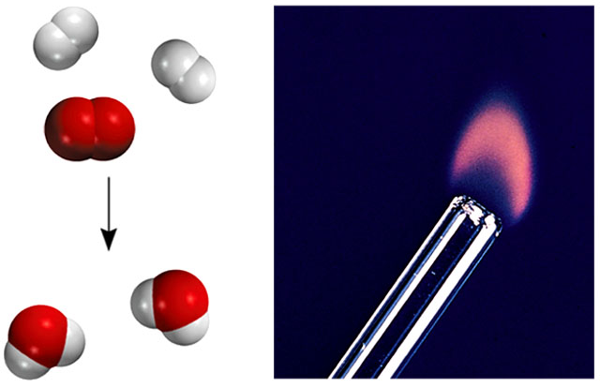
Types of Changes
A physical change does not alter the composition or identity of a substance.
sugar dissolving
in water
ice melting
A chemical change alters the composition or identity of the substance(s) involved.
hydrogen burns in air to form water

Slide 12
PROBLEM: Decide whether each of the following process is primarily a physical or a chemical change, and explain briefly.
Frost forms as the temperature drops on a humid winter night.
(b) Dynamite explodes to form a mixture of gases.
(c) Dissolving sugar and water.
(d) A silver fork tarnishes in air.
Criteria: “Does the substance change composition or just change form?”

Slide 13
SOLUTION:
physical change
(b) chemical change
(c) physical change
(d) chemical change

Slide 14
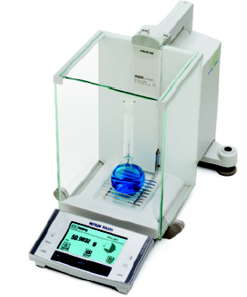
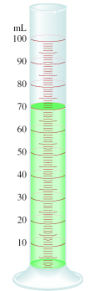

Extensive and Intensive Properties
An extensive property of a material depends upon how much matter is is being considered.
mass
length
volume
An intensive property of a material does not depend upon how much matter is is being considered.
density
temperature
color

Slide 15
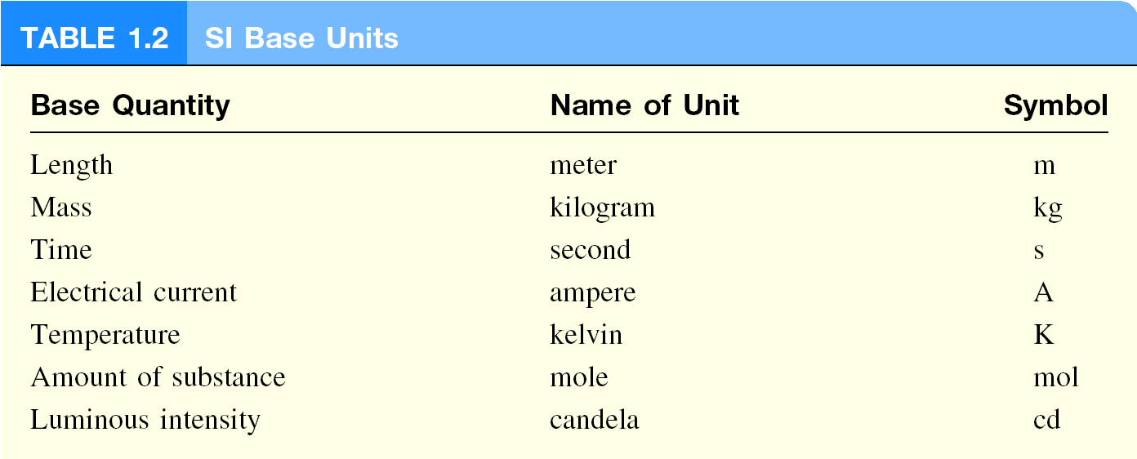
International System of Units (SI)

Slide 16
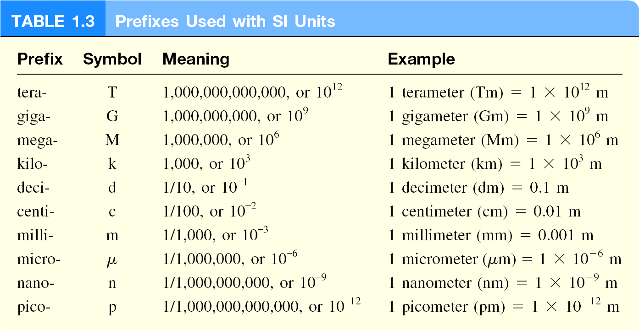

Slide 17
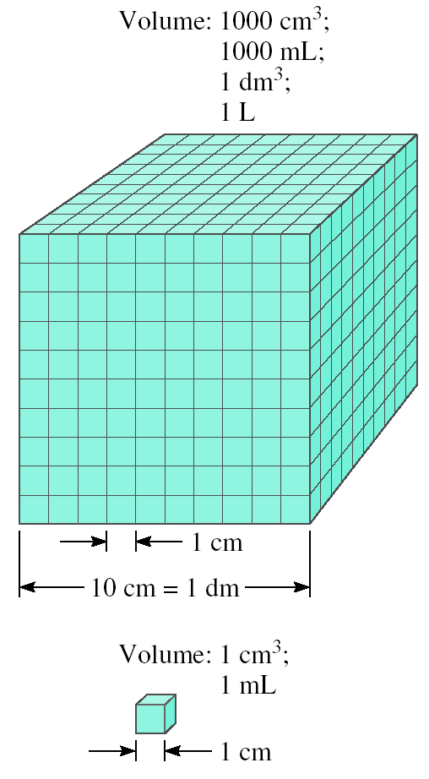
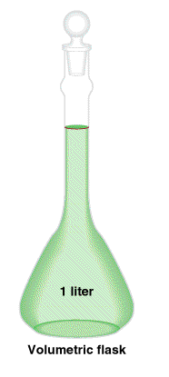
Volume – SI derived unit for volume is cubic meter (m³)
1 cm³ = (1 x 10⁻² m)³ = 1 x 10⁻⁶ m³
1 dm³ = (1 x 10⁻¹ m)³ = 1 x 10⁻³ m³
1 L = 1000 mL = 1000 cm³ = 1 dm³
1 mL = 1 cm³

Slide 18
Density
The density a substance is its mass per unit volume (the volumetric mass).
SI derived unit for density is kg/m³
1 g/cm³ = 1 g/mL = 1000 kg/m³
mass
m
density =
d =
volume
V

Slide 19
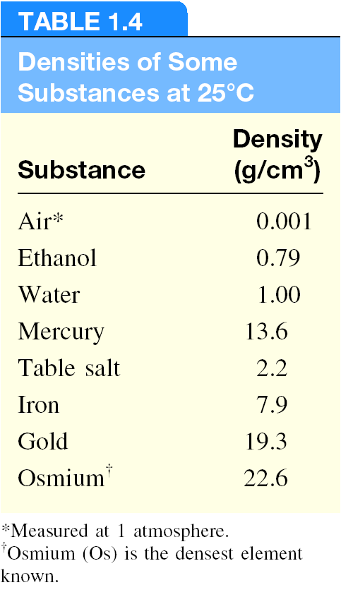

Slide 20
A piece of platinum metal with a density of 21.5 g/cm³ has a volume of 4.49 cm³. What is its mass?
m
d =
V
m = d x V
= 21.5 g/cm³ x 4.49 cm³ = 96.5 g

Slide 21
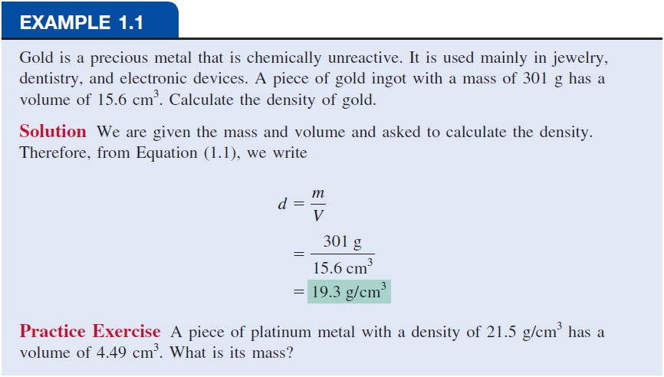

Slide 22
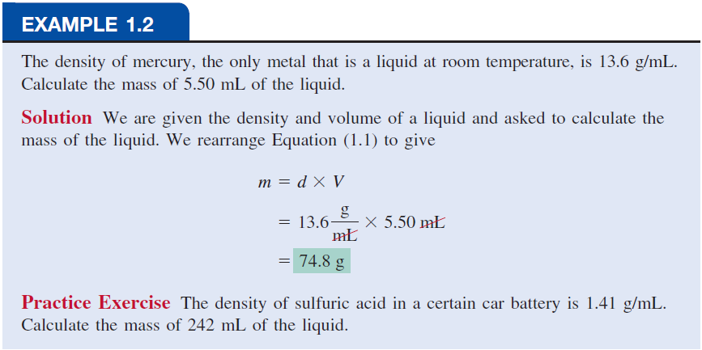

Slide 23
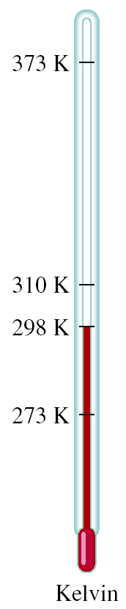
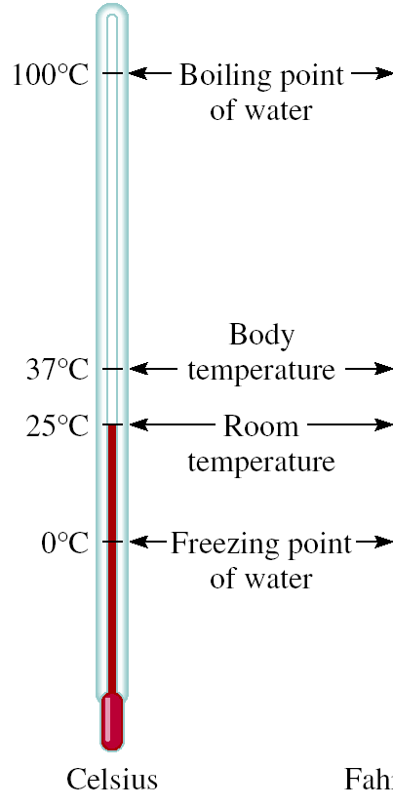
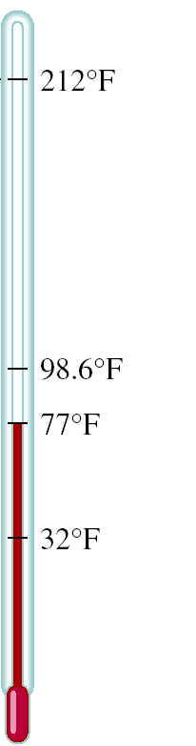


A Comparison of Temperature Scales
K = ⁰C + 273.15
273 K = 0 ⁰C
373 K = 100 ⁰C
9
⁰F = x ⁰C + 32
5
32 ⁰F = 0 ⁰C
212 ⁰F = 100 ⁰C

Slide 24
Convert 172.9 ⁰F to degrees Celsius.
9
⁰F = x ⁰C + 32
5
9
⁰F – 32 = x ⁰C
5
5
x (⁰F – 32) = ⁰C
9
5
⁰C = x (⁰F – 32)
9
5
⁰C = x (172.9 – 32) = 78.3
9

Slide 25
